Slide 1
Minimize Risk in Credit Card Transactions
Presented By:
David Musili
Griffin Roberts
Michael Lima
March 4th, 2024

Slide 2

Agenda
01. About Us
02. Our Clients
Provide an overview of our company
Discuss the solutions that we provide
03. Our Solutions
04. Model Demo
05. Data Analysis
06. Conclusion
TBD
TBD
.
TBD
TBD
February 29, 2024

Slide 3
1. About Us
DataInsight Solutions is a dynamic startup at the forefront of harnessing the power of data science to drive innovation and informed decision-making.
Founded by a team of experienced data scientists and industry experts, we offer cutting-edge solutions to unlock the full potential of data for businesses across various sectors.
From predictive analytics to machine learning and AI-driven insights, we empower our clients to extract actionable intelligence from their data, enabling them to stay ahead in today's rapidly evolving digital landscape.
Our commitment to excellence, coupled with a passion for solving complex challenges, sets us apart as the trusted partner for organizations seeking to leverage data as a strategic asset. At DataInsight Solutions, we turn data into value, transforming businesses and shaping the future of industries.
February 29, 2024

Slide 4





2. Our Clients
February 29, 2024

Slide 5

2. The Problem
Presenter: Michael Lima

Slide 6
Problem Statement
In the complex landscape of financial transactions, the paramount challenge for banks is the identification and prevention of credit card fraud. The issues that complicate credit card fraud detection include:
Extensive Data Analysis: Our banking systems process an overwhelming amount of transactions daily, necessitating a fraud detection model that is both efficient and effective.
Prevalence of Non-Fraudulent Transactions: With the vast majority (99.8%) of transactions being legitimate, distinguishing the fraudulent ones becomes a substantial task.
Privacy-Protected Data: Access to transaction data is restricted due to privacy concerns, which can hinder fraud detection efforts.
Risk of Misclassification: The potential for fraudulent transactions to go undetected or be wrongly classified poses a significant threat.

Slide 7
Data Insight’s Approach
Data Insight presents a specialized solution to these challenges with a strategic focus on effective fraud detection:
Advanced Analytics for Large-Scale Data: Our model is meticulously designed to thoroughly analyze vast datasets, ensuring comprehensive fraud detection without compromising on quality.
Innovative Techniques for Imbalanced Data: We employ sophisticated methods to address data imbalance, thereby enhancing the detection of fraudulent transactions amidst a sea of legitimate activity.
Adaptable Model: The strength of our model lies in its simplicity. It is built to adapt seamlessly to the changing patterns of fraudulent behavior, allowing for quick updates and redeployment of the detection system as needed.
Entrust your bank's fraud detection to Data Insight, where we prioritize effective, precise, and privacy-conscious solutions to protect your customers and maintain the highest standard of financial security.

Slide 8

3. DataInsight’s Solution
Presenter: Griffin Roberts

Slide 9
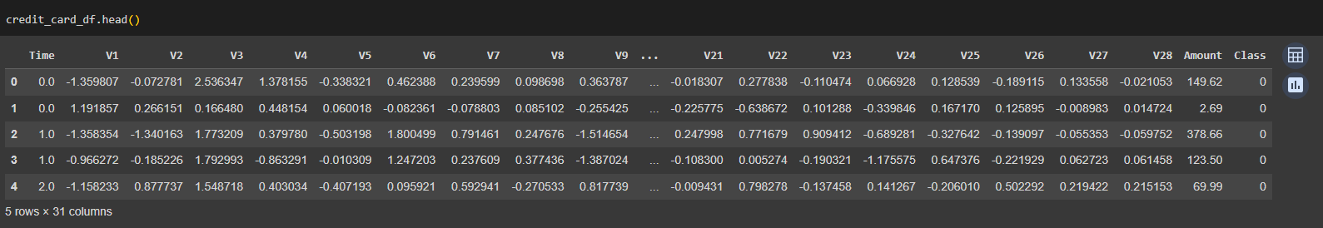
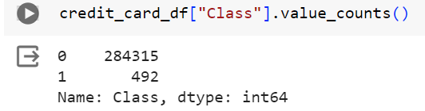
Data Exploration Process
How did we explore the data?
The data was already anonymized
The data had more valid transactions than fraud transactions

Slide 10
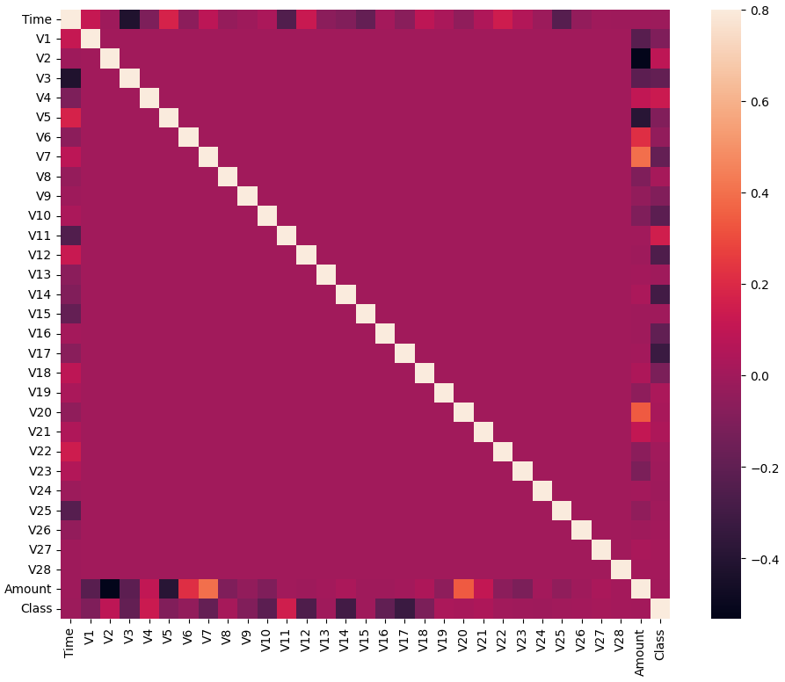
Data Exploration Process (continued)
How did we explore the data?
3. There is minimal correlation

Slide 11
Data Preprocessing
How we cleaned up the data
We dropped the time from the X data and separated the target
We split the training and test data
We scaled the x data using MinMaxScaler
We oversampled the training data
We undersampled the testing data

Slide 12

Model Perfomance

Slide 13
Models
Model | Training Score | Test Score | Recall (fraudulent) | F1 (non Fraudulent) | F1 Macro Average
Decision Tree Classifier | 1.0 | 0.99919 | 0.76 | 1.00 | 0.87
Random Forest | 0.94510 | 0.93878 | 0.89 | 0.94 | 0.94
K-Nearest Neighbor | 0.99954 | 0.92857 | 0.86 | 0.93 | 0.93
Support Vector Classifier | 0.9609 | 0.9490 | 0.92 | 0.95 | 0.95
XG Boost | 1.0 | 0.99950 | 0.78 | 1.00 | 0.91
ADA Boost Classifier | 0.97383 | 0.95408 | 0.92 | 0.96 | 0.95
Logistic Regression | 0.9991 | 0.999 | 0.86 | 1.00 | 0.77
Gradient Boosting Classifier | 0.99524 | 0.95408 | 0.92 | 0.96 | 0.95

Slide 14
Top Performing Models
Based on our analysis, we determined that the top 3 models are
Support Vector Classifier
ADA Boost Classifier
Gradient Boosting Classifier
The primary determining factors were
High Recall i.e. the ability for the model to detect fraud
There was a low difference between training and test data scores.
The High F1 scores show that there balance between fraud detection and reducing false positives

Slide 15
Pros and Cons of the Top Models
Support Vector Classifier
Pros
Low risk of overfitting.
Effective recall.
Cons
Hard to interpret model’s logic.
Retraining model takes a long time.
ADA Boost Classifier
Pros
Exhibits strong performance metrics with high precision and recall, particularly important for detecting fraudulent transactions.
Consistent training and testing scores suggest good generalization without overfitting.
Cons
Have a higher differences between the training and testing score accuracy.
Sensitive to noisy data and outliers.
Gradient Boosting Classifier
Pros
High accuracy and strong performance in identifying non-fraudulent transactions.
Good recall for fraud, indicating robustness in detecting fraudulent activities.
Cons
Have a higher differences between the training and testing score accuracy.
Can be prone to overfitting.

Slide 16
Pros and Cons of the Top Models
Support Vector Classifier
Pros
Low risk of overfitting
Effective recall
Cons
Hard to interpret model’s logic
Retraining model takes a long time
ADA Boost Classifier
Pros
Strong performance metrics
Low risk of overfitting.
Cons
Potential performance imbalance
Sensitive to noisy data and outliers
Gradient Boosting Classifier
Pros
Good recall for fraud
Reduces risk of misidentifying fraud as non fraudulent
Cons
Low precision on fraudulent transactions
Can be prone to overfitting

Slide 17
Recommendations
We recommend Support Vector Classifier Model for Credit Card fraud detection.
Why?
It averages 94-95% accuracy predicting fraud.
Has a relatively high recall when identifying fraudulent charges.
Very memory efficient because it uses a subset of training points.

Slide 18
References
https://statinfer.com/204-6-8-svm-advantages-disadvantages-applications/
https://www.kaggle.com/datasets/mlg-ulb/creditcardfraud?resource=download

Slide 19

Thank you

